Slide 1
Portugal Journey
Made by božo skukan,jakov murar and marko matičević

Slide 2
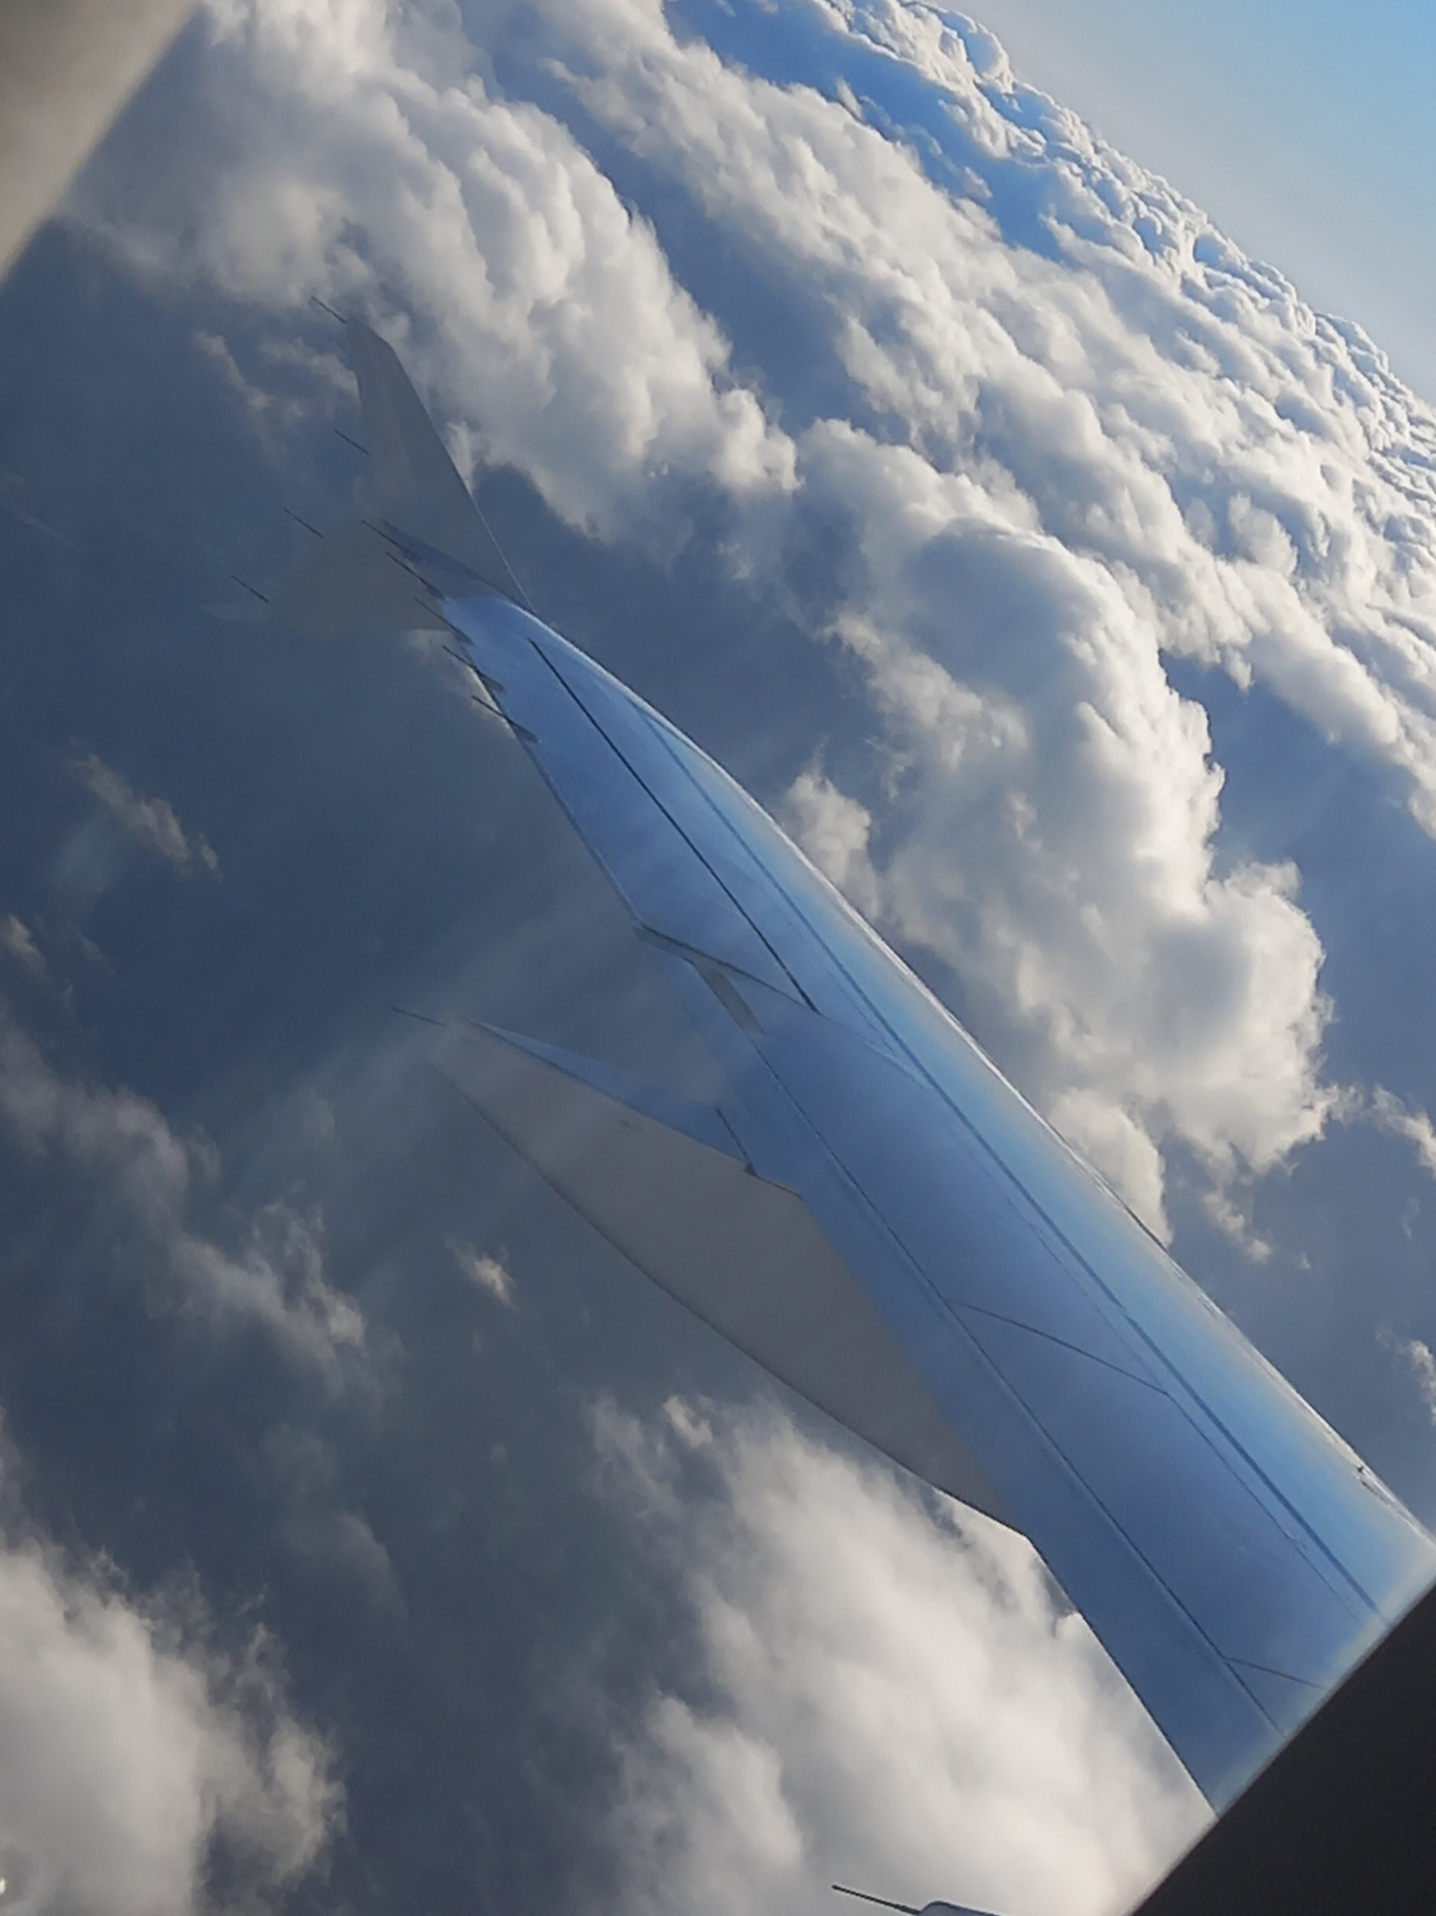
Sunday
We didn’t do much on the first day,just traveling
At the airport,we were just waiting for others to come
Airplanes aren’t that scary as i thought they would be,the scariest thing is going really fast on the ground,it gets really loud
We traveled from Zagreb to Frankfurt and from
Frankfurt to Lisabon

Slide 3
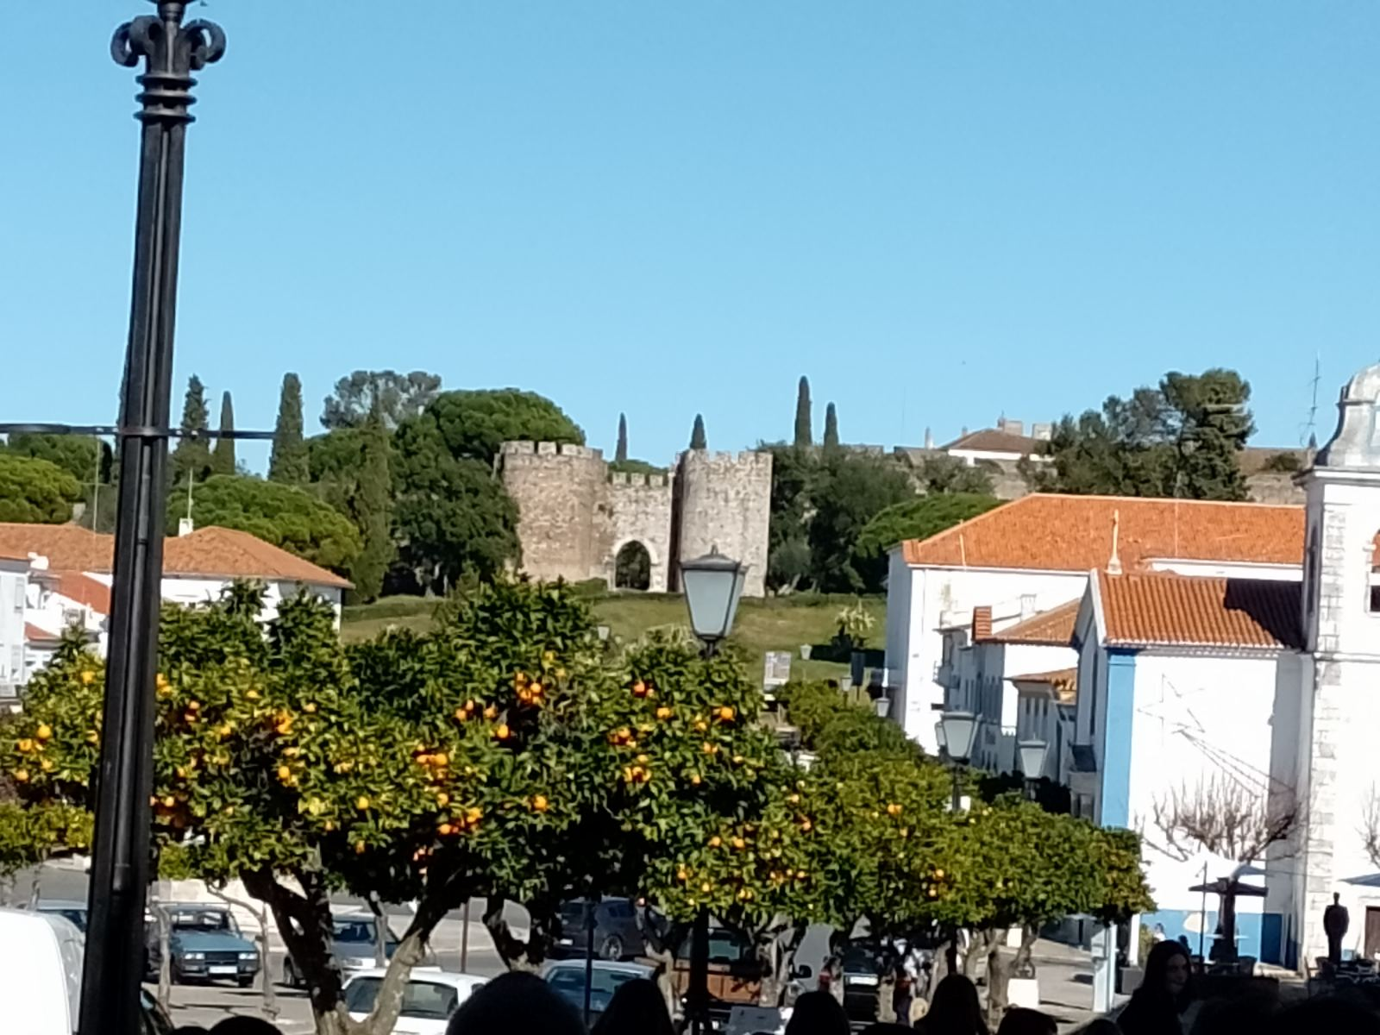
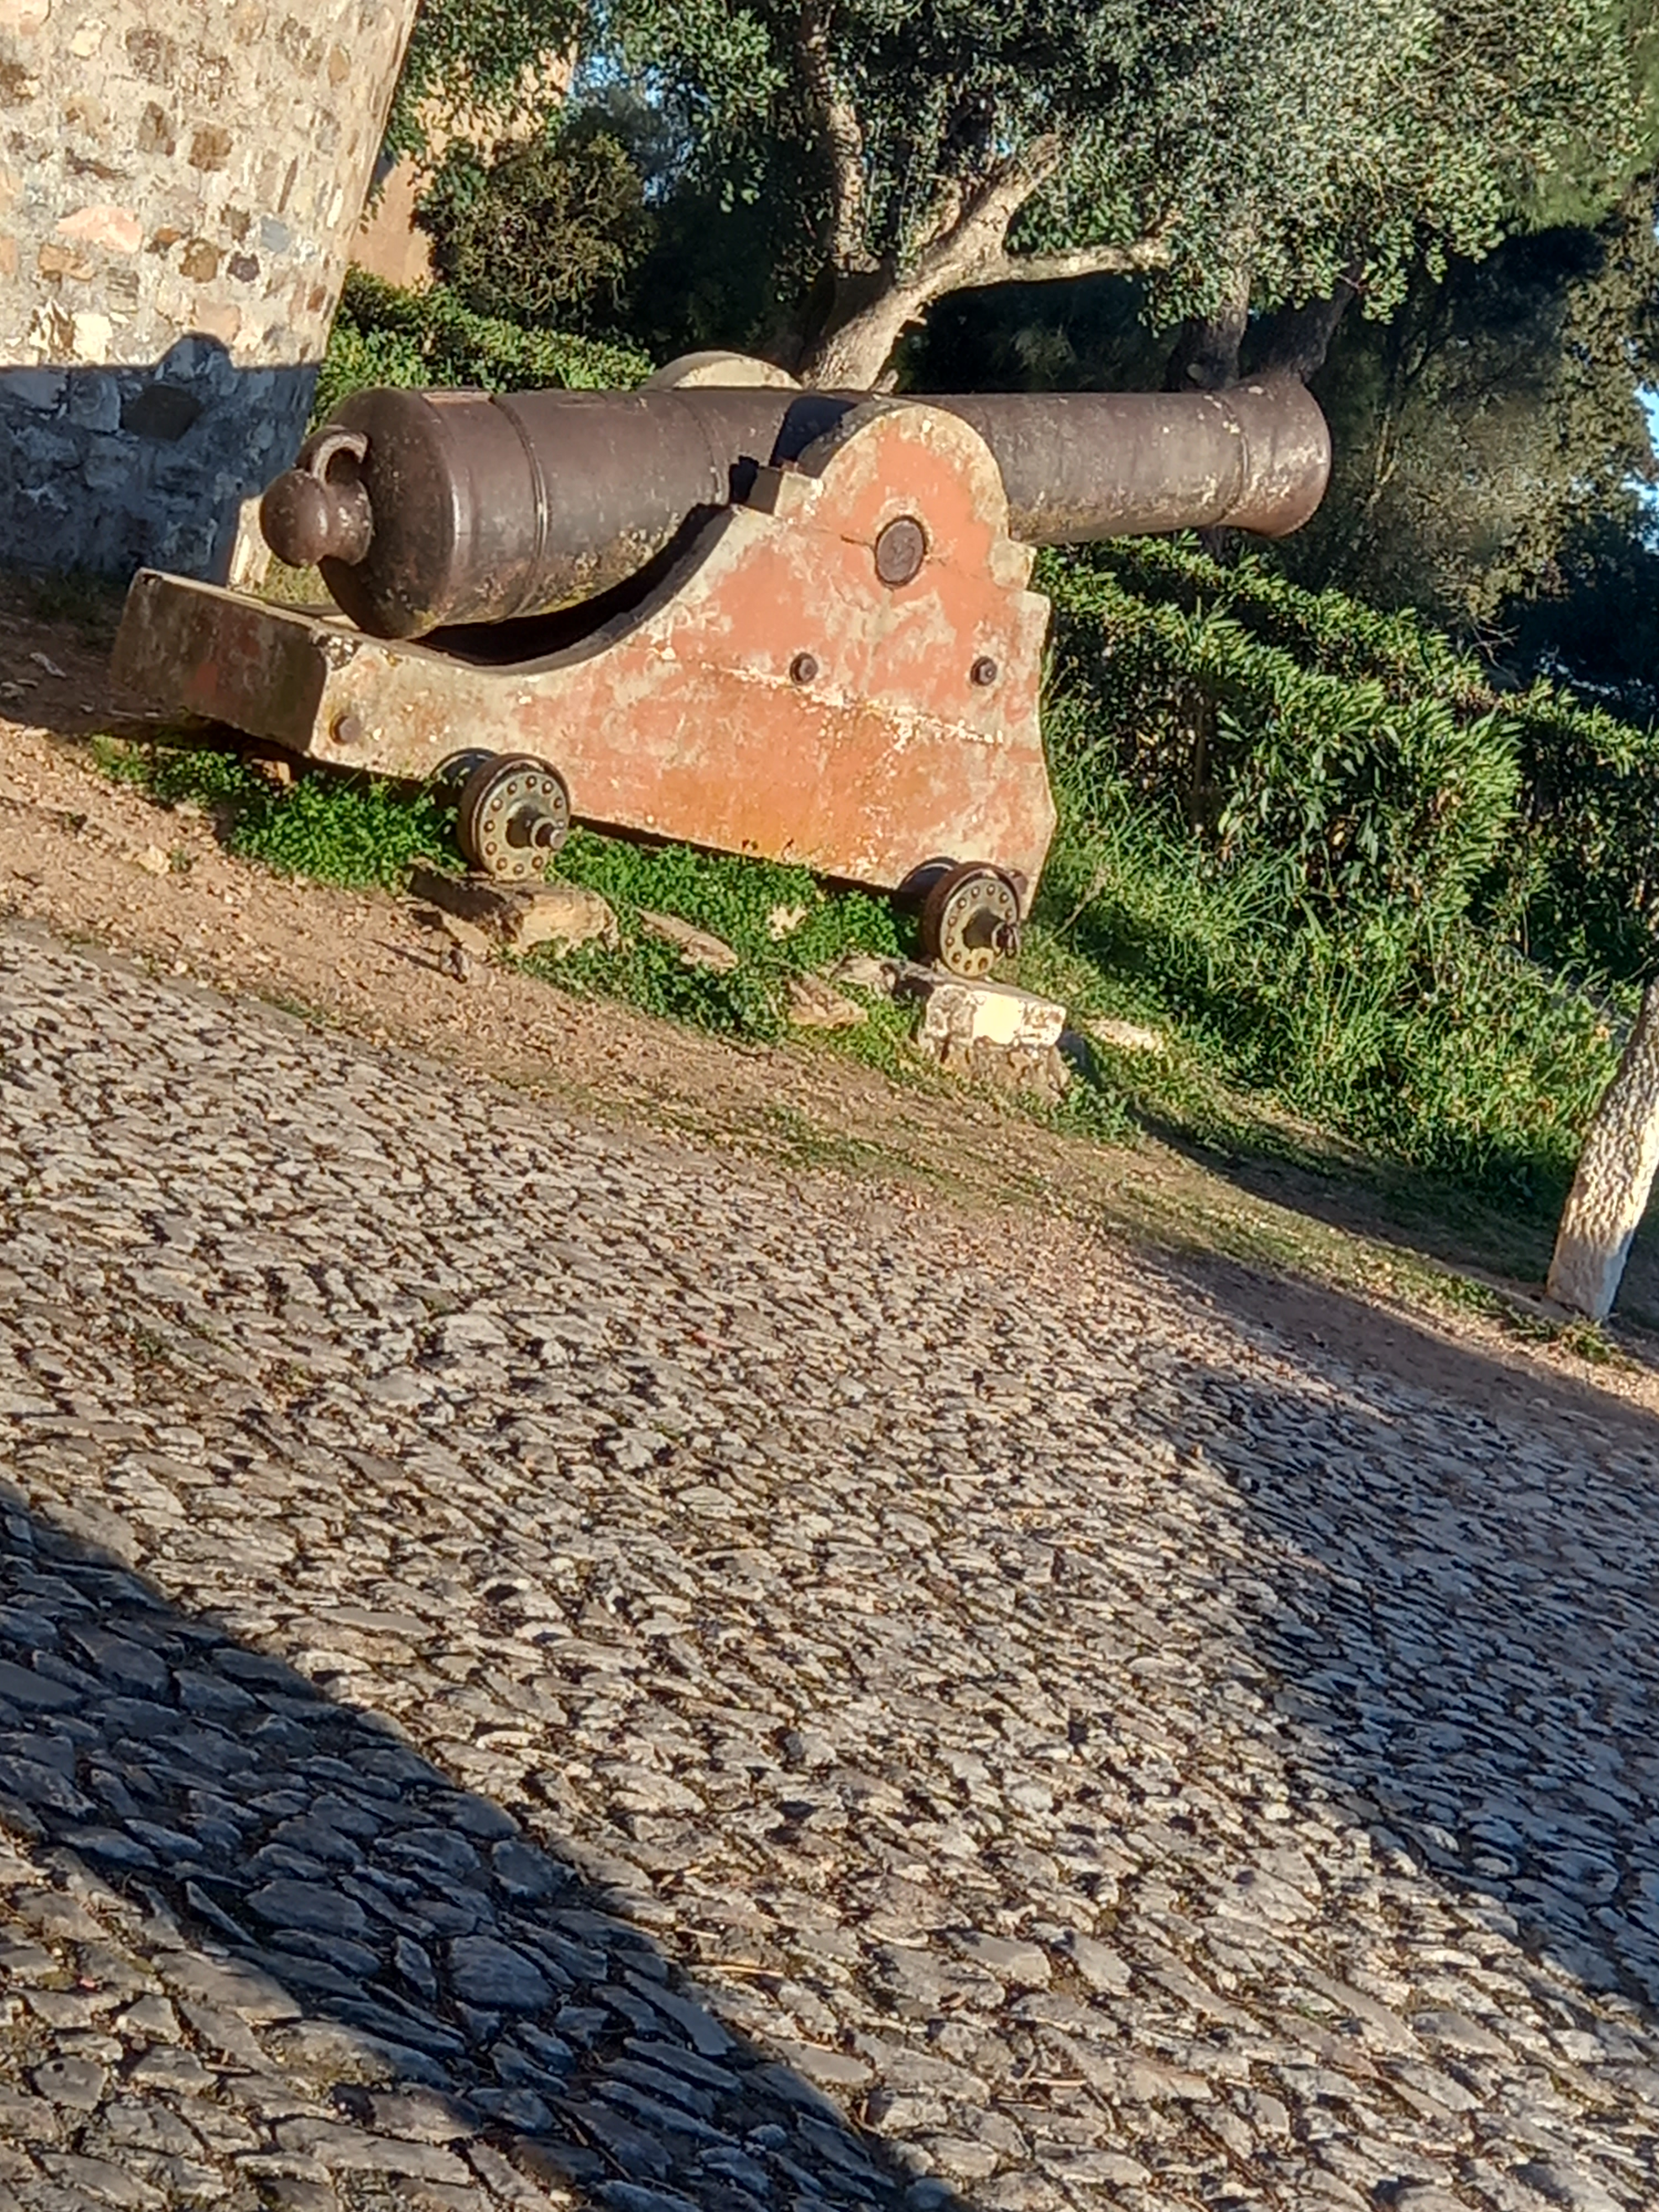
Monday
We had Introduction games in Vila Vicosa’s school
We had brunch and had an visiting the school,thier school is almost three times bigger than schools in Požega
After that we visited Sanctuary and Castle

Slide 4
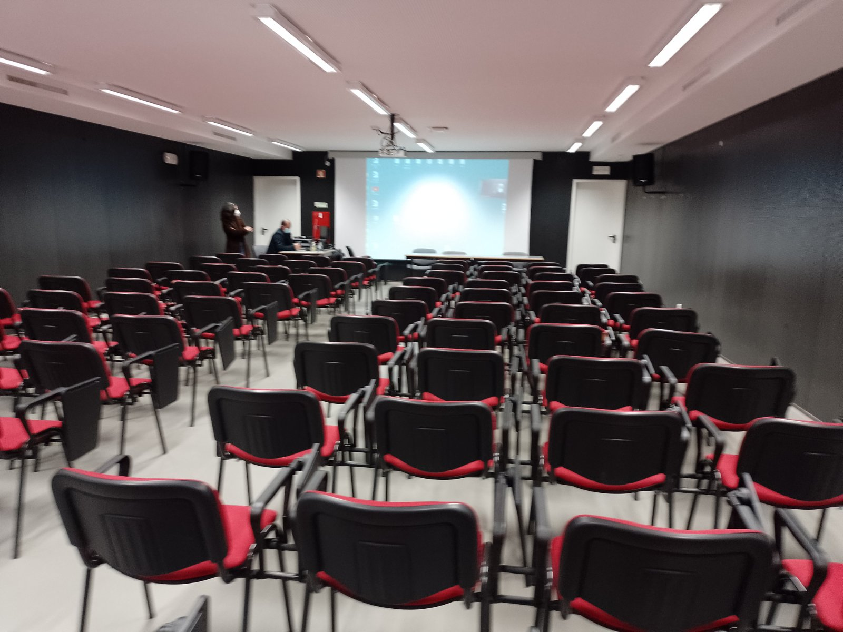
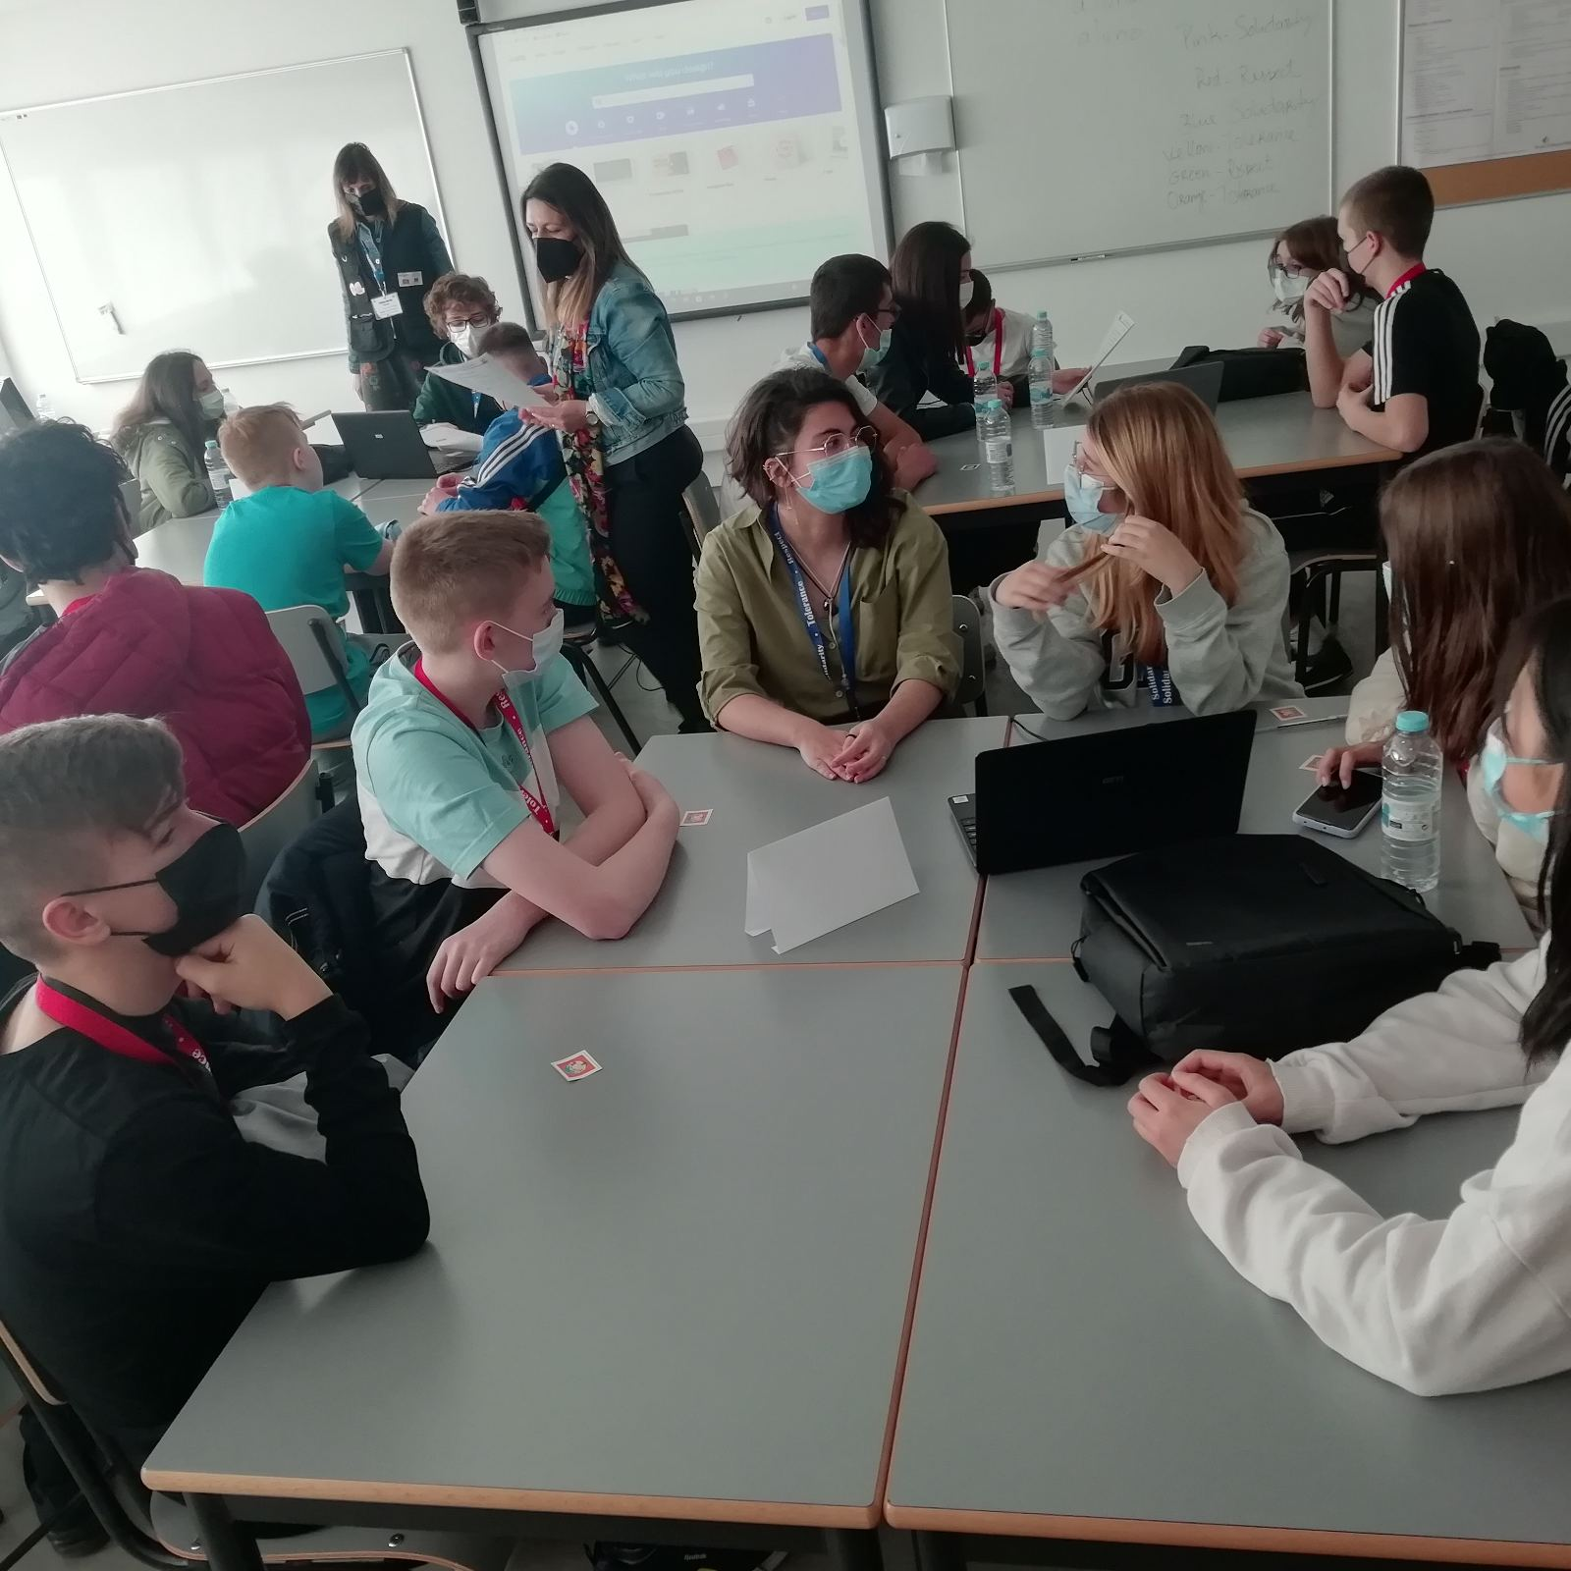
Tuesday
It was the most stressful day on the whole journey because we had to present our presentations
Their school has a whole classroom just for presenting
We also had activites about values:

Slide 5
Observatory
It was the most fun place we visited on our journey
We had a presentation and late at night, we looked through the telescope:
Sky was really beautiful at night:

Slide 6
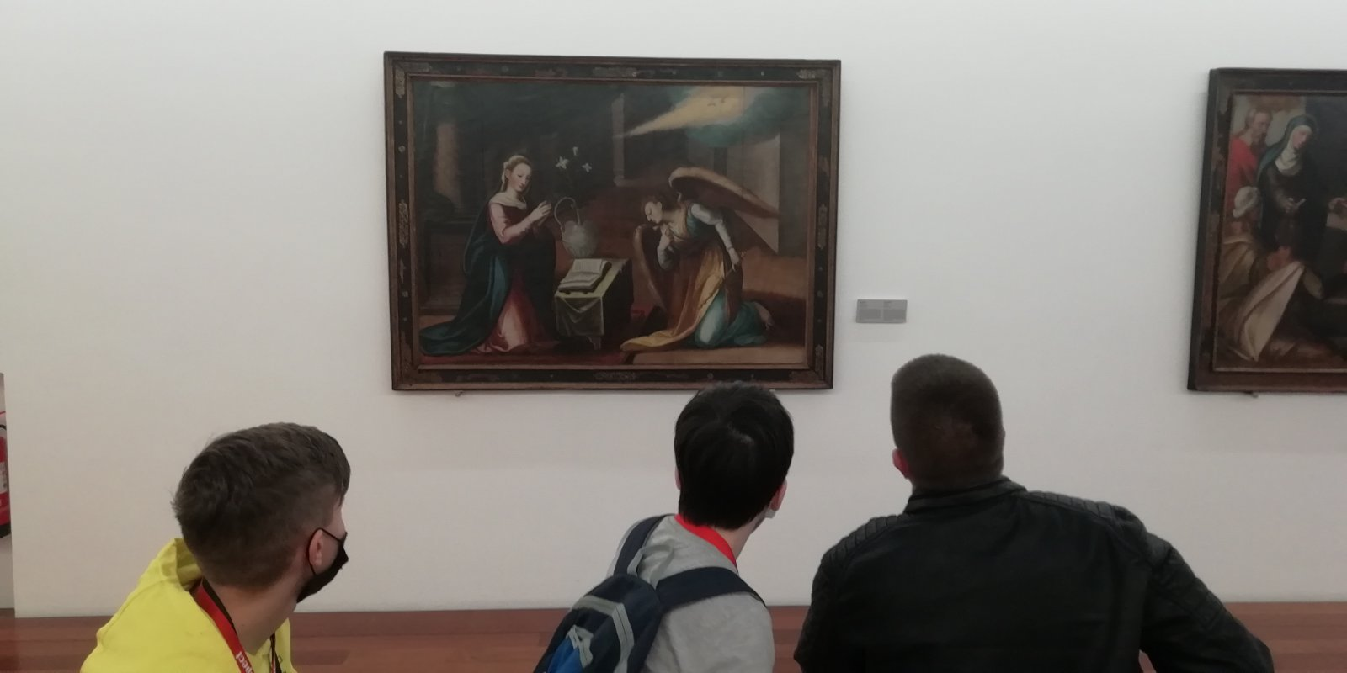
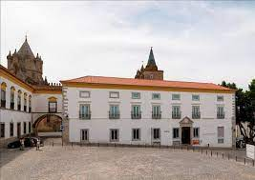
Wednesday
Wednesday was a day full of adventuring,we have went to city called Evora
We were in art museum looking at all of weird yet intersting art masterpieces

Slide 7
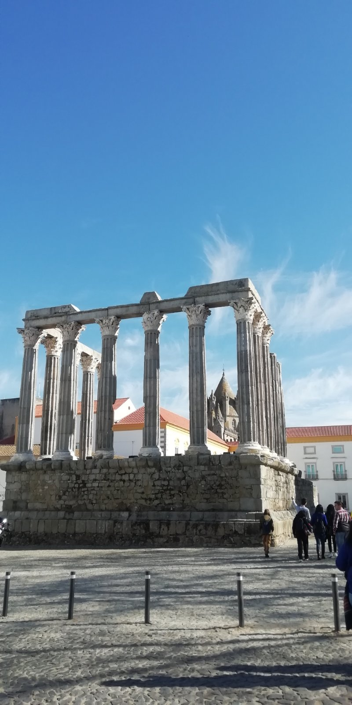
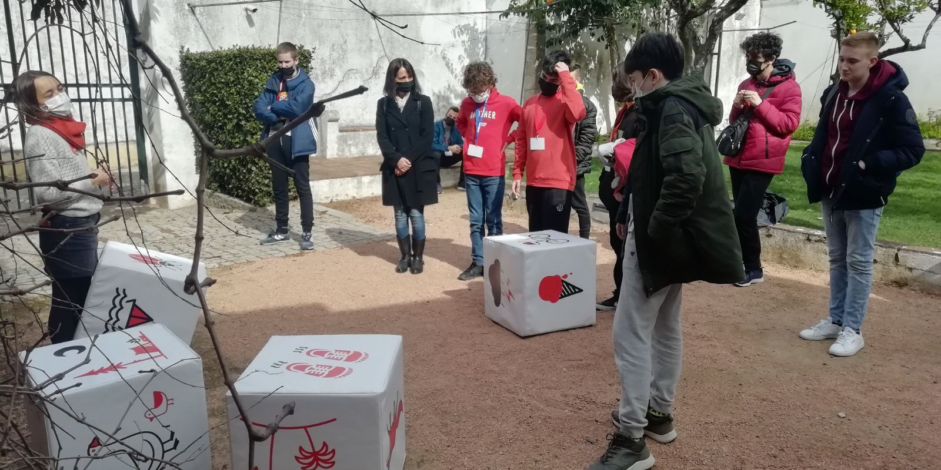
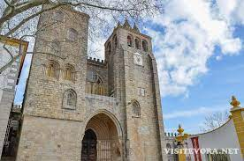
Other activities
After our team finished with museum tour we played
Little game,we were supposed to throw 4 dices and on what picture it lands we made story about it
When that ended we went sightseeing with guidance

Slide 8
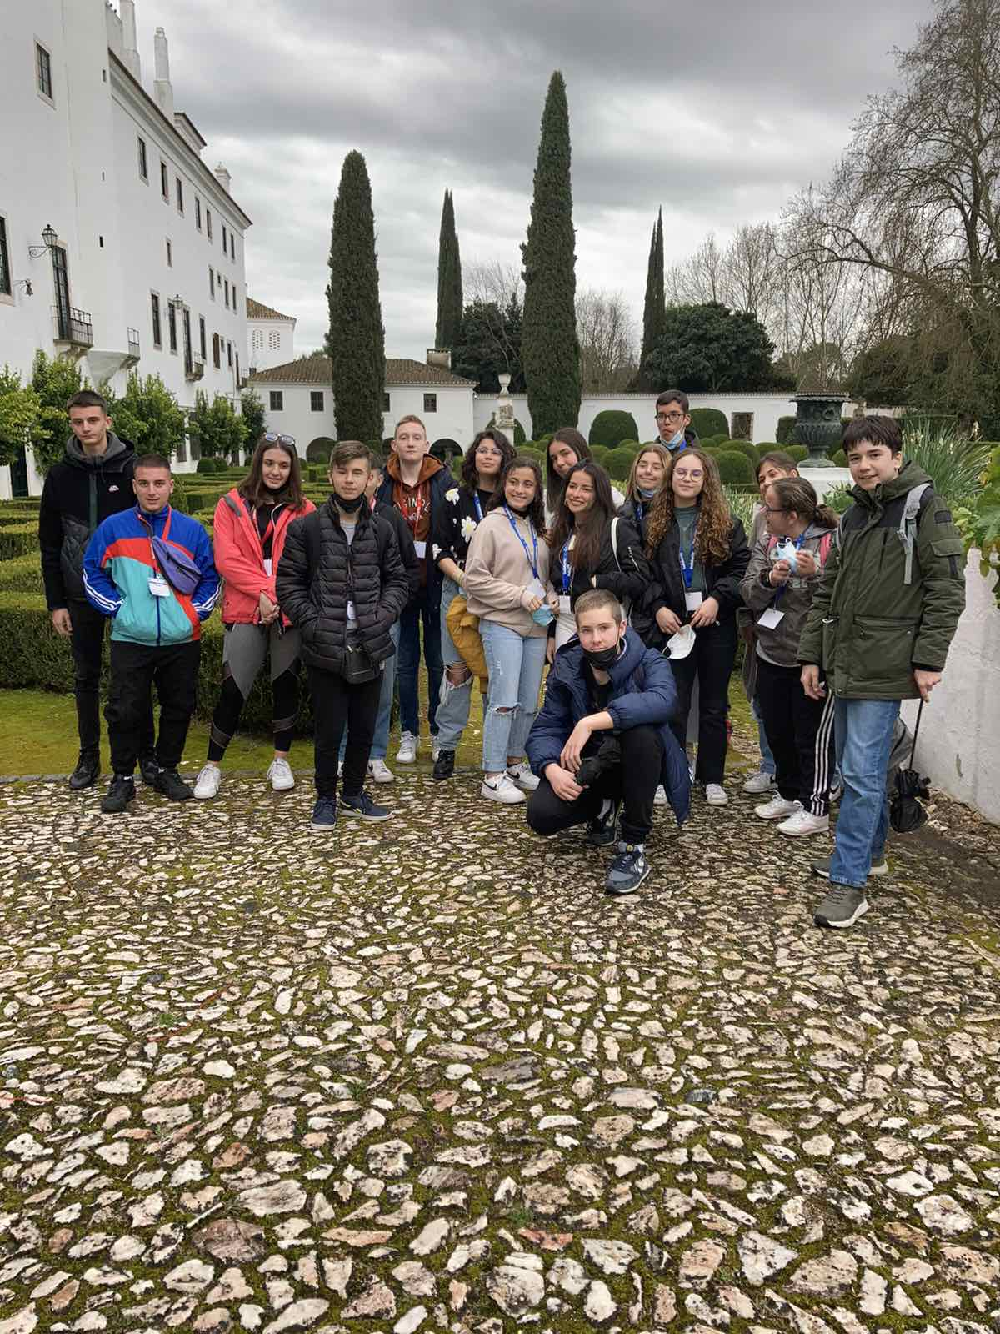
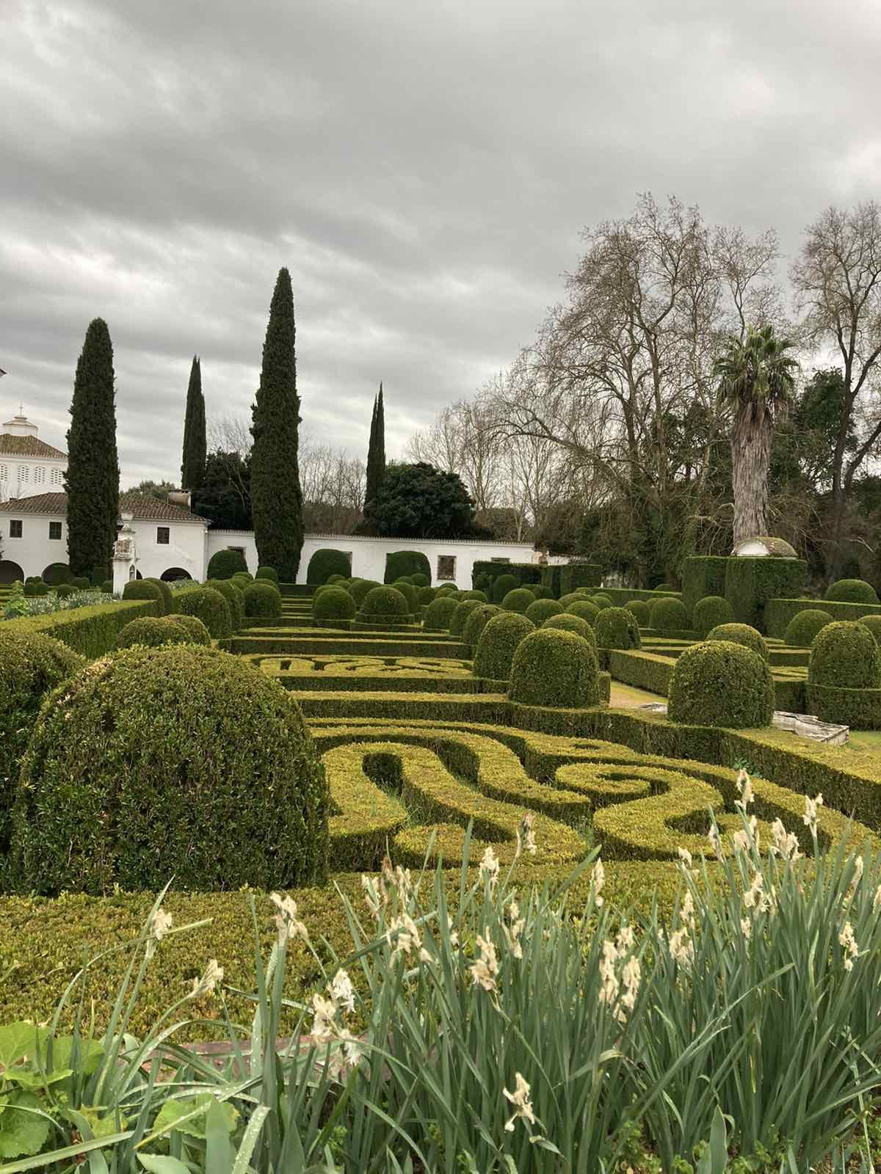
Thursday
On Thursday we didnt really went anywhere then school
We had a little DIY (Do it yourself) program in which we should make flowers,we got many pens,scissors,hot glue and many other items
Later that day we went to visit Vila Viçosa palace,unfortunately we were not supposed to take any pictures inside,but we could outside

Slide 9
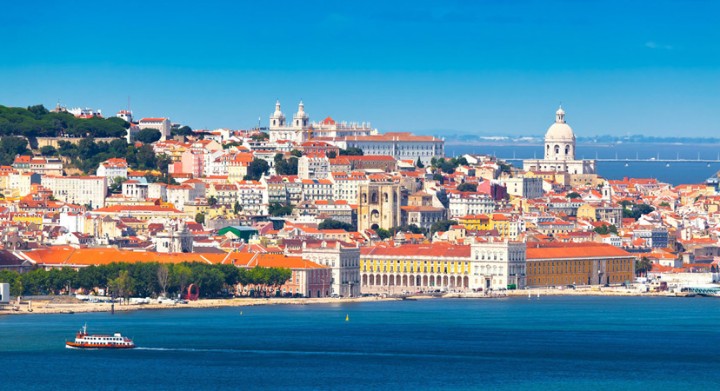
Friday
On Friday we started early. At 7.30AM we went to Lisbon and we did some sightseeings. It’s very beautiful and I wish that we stayed there forever.
We played some games to know the city better.
That night we stayed at a beautiful hotel.

Slide 10
Saturday
On Saturday we packed our luggage and prepared for going back home, where we came from. We had a great experience and we wish that You, one day, come and visit Portugal.

Slide 11
CONCLUSION:
It was epic!

Slide 12
Thank you for your attention!

